Slide 1
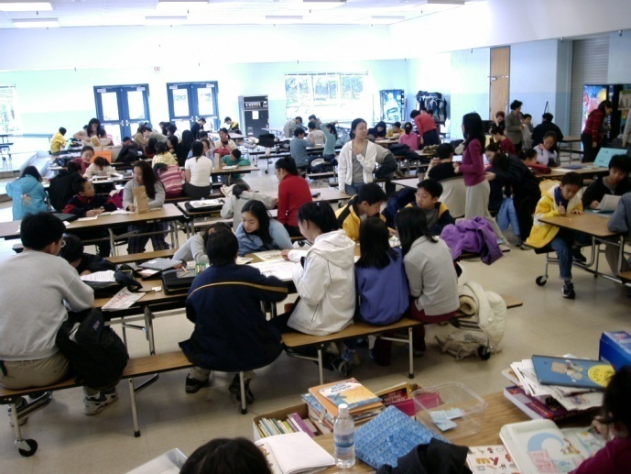
Mission
Provide tutoring services to new immigrants and other needy students
Share experiences with new immigrant families in Montgomery County in adjusting to the society
Provide community service and leadership opportunities to qualified high and middle school students
Present educational-related issues and needs to Montgomery County Public Schools (MCPS)
Fee
Free Membership
Tutoring service to all CAPSA members (age 5 or older)
$20 shared facility rental fee for each tutor or coordinator annually
$30 shared facility rental fee for each tutee annually
Organization
Chinese American Parents and Students Association (CAPSA) is a non-profit volunteer organization
Program Director oversees the entire tutoring operation
Additional positions include:
Deputy directors
Group mentors
Monitors
Lead coordinators
Coordinators
Tutors
Other monitoring and administrative support staff
Approach
Qualified middle and high school students are selected to be tutors
One-on-one tutoring services are promoted, whenever feasible, for needy students and adults to help with their homework and adapting to the American culture and environment
Tutors provide tutoring services to needy students and gain MCPS Student Service Learning (SSL) hours and valuable experience
Promising tutors are selected as coordinators to ensure the smooth operations of the group and arrange tutor and tutee match-ups
Adult volunteers provide mentorship, monitoring and administrative support
2019-2020 Schedule
Sep 7, 14, 21, 28
Oct 5, 12, 19, 26
Nov 2, 9, 16, 23
Dec 7, 14
Jan 4, 11, 18, 25
Feb 1, 8, 15, 22, 29
Mar 7, 14, 21, 28
Apr 18, 25
May 2, 9, 16
Time: Saturday 10 am – 12 noon
Location
Robert Frost Middle School
9201 Scott Drive
Rockville, MD 20850
Resources
English textbooks and dictionaries
Novels and reading books
Supplemental workbooks and worksheets
Recent magazines
“Side by Side” ESOL English sets
For More Information
Call (301) 686-4237
www.capsa-mc.org
capsa.mcmd@gmail.com
CAPSA, A 501(c)(3) Non-Profit Organization

Slide 2

宗旨
為華裔學生、 新移民及有需要輔導人士提供課業輔導。
幫助新移民家庭在蒙郡教育制度中適應生活環境。
提供成績優秀的中學生義工服務、 領導才能和教學機會。
向蒙郡公立學校當局表達對教育方針及教學需要的意見。
輔導方式
由成績優秀的中學生擔任義務小老師， 採取一對一的方式， 協助學生及有需要輔導人士解決課業問題及適應本地的文化與生活。
小老師會優先指示學生帶來的學校功課，並輔導其作業。
輔導班備有各種不同程度的書籍、 字典及作業單張，作為基本輔導教材。
擔任小老師的學生可獲蒙郡公立學校認可的社區時數。
有工作熱誠、 領導才能和教學經驗的小老師們， 將可申請擔任輔導協調員，直接參與輔導班策劃工作。
熱心成人義工擔任輔導、行政和管理工作。
地 點
Robert Frost Middle School
9201 Scott Drive
Rockville, MD 20850
2019-20上課日期
九 月: 7,14,21,28
十 月: 5,12,19,26
十一月: 2,9,16,23
十二月: 7,14
一 月: 4,11,18,25
二 月: 1,8,15,22,29
三 月: 7,14,21,28
四 月: 18,25
五 月: 2,9,16
星期六上午十時至中午十二時
費用
不收會員費， 課業輔導只提供給五歲或以上會員
小老師/協調員每學年場地均攤費每人 $20
學生每學年場地均攤費每人 $30
詳情請致電/上網/電郵查詢
(301) 686-4237
www.capsa-mc.org
capsa.mcmd@gmail.com
CAPSA, A 501(c)(3) Non-Profit Organization
Chinese American
Parents and Students
Association
Tutoring Program
蒙郡華裔家長 學生協會
課 業 輔 導

